Slide 1
Linear Regression
Chapter 7

Slide 2
What is Regression?
A way of predicting the value of one variable from another.
It is a hypothetical model of the relationship between two variables.
The model used is a linear one.
Therefore, we describe the relationship using the equation of a straight line.

Slide 3
Model for Correlation
Outcome_{i} = (bX_{i} ) + error_{i}
Remember we talked about how b is standardized (correlation coefficient, r) to be able to tell the strength of the model
Therefore, r = model + strength instead of M + error.

Slide 4
Describing a Straight Line
b_{i}
Regression coefficient for the predictor
Gradient (slope) of the regression line
Direction/Strength of Relationship
b₀
Intercept (value of Y when X = 0)
Point at which the regression line crosses the Y-axis (ordinate)

Slide 5
Intercepts and Gradients

Slide 6
Types of Regression
Simple Linear Regression = SLR
One X variable (IV)
Multiple Linear Regression = MLR
2 or more X variables (IVs)

Slide 7
Types of Regression
MLR Types
Simultaneous
Everything at once
Hierarchical
IVs in steps
Stepwise
Statistical regression (not recommended)

Slide 8
Analyzing a regression
Is my overall model (i.e. the regression equation) useful at predicting the outcome variable?
Model summary, ANOVA, R²
How useful are each of the individual predictors for my model?
Coefficients, t-test, pr²

Slide 9
Overall Model
Remember that ANOVA was a subtraction of different types of information
SStotal = My score – Grand Mean
SSmodel = My level – Grand Mean
SSresidual = My score – My level
(for one-way ANOVAs)
This method is called least squares

Slide 10
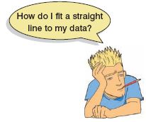
The Method of Least Squares

Slide 11
Sums of Squares

Slide 12
Summary
SS_{T}
Total variability (variability between scores and the mean).
My score – Grand mean
SS_{R}
Residual/Error variability (variability between the regression model and the actual data).
My score – my predicted score
SS_{M}
Model variability (difference in variability between the model and the mean).
My predicted score – Grand mean

Slide 13
Overall Model: ANOVA
SS_{T}
Total Variance In The Data
SS_{M}
SS_{R}
Improvement Due to the Model
Error in Model
If the model results in better prediction than using the mean, then we expect SS_{M} to be much greater than SS_{R}

Slide 14
Overall Model: R²
R²
The proportion of variance accounted for by the regression model.
The Pearson Correlation Coefficient Squared

Slide 15
Individual Predictors
We test the individual predictors with a t-test.
Think about ANOVA > post hocs … this order follows the same pattern.
Single sample t-test to determine if the b value is different from zero
Test statistic = b / SE, which is the same thing we’ve been doing … model / error

Slide 16
Individual Predictors
t values are traditionally reported, but the df aren’t obvious in R.
df = N – k – 1
N = total sample size, k = number of predictors
So correlation = N – 1 – 1 = N – 2
(what we did last week)
Also df residual on the output (df error)

Slide 17
Individual Predictors
b = unstandardized regression coefficient
For every one unit increase in X, there will be b units increase in Y.
Beta = standardized regression coefficient
b in standard deviation units.
For every one SD increase in X, there will be ϐ SDs increase in Y.

Slide 18
Individual Predictors
b or beta? Depends:
b is more interpretable given your specific problem
Beta is more interpretable given differences in scales for different variables

Slide 19
Data Screening
Now we want to look specifically at the residuals for Y … while screening the X variables
We used a random variable before to check the continuous variable (the DV) to make sure they were randomly distributed

Slide 20
Data Screening
Now we don’t need the random variable because the residuals for Y should be randomly distributed (and evenly) with the X variable
So we get to data screen with a real regression
(rather than the fake one used with ANOVA).

Slide 21
Data Screening
Missing and accuracy are still screened in the same way
Outliers – (somewhat) new and exciting!
Multicollinearity – same procedure**
Linearity, Normality, Homogeneity, Homoscedasticity – same procedure
(but now on the real regression)

Slide 22
Example
C7 regression data
CESD = depression measure
PIL total = measure of meaning in life
AUDIT total = measure of alcoholism
DAST total = measure of drug usage
CESD = AUDIT + PIL

Slide 23
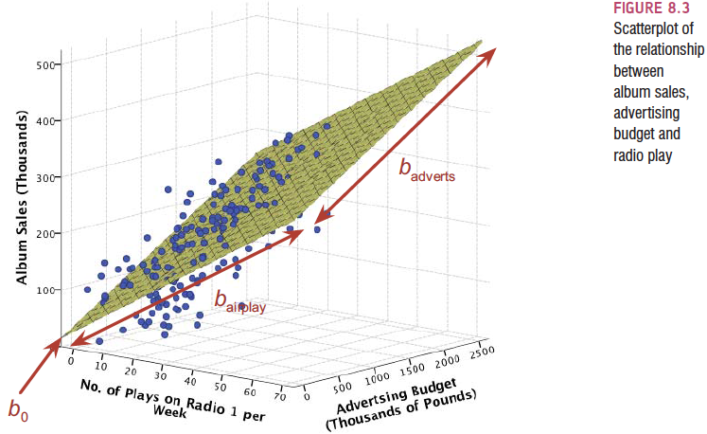
Multiple Regression

Slide 24
Run the Regression
You know that LM function we’ve been using?
Yes! You get to use it again.
Same Y ~ X + X format we’ve been using.

Slide 25
Data Screening
First, let’s do Mahalanobis
Same rules apply with mahalanobis() function
But now we are going to save a column of data that includes if they are above the cut off score or not.

Slide 26
Data Screening
Outliers
Leverage – influence of that person on the slope
What do these numbers mean?
Cut off = (2K+2)/N
To get them in R
hatvalues(model)

Slide 27
Data Screening
Outliers
Influence (Cook’s values) – a measure of how much of an effect that single case has on the whole model
Often described as leverage + discrepancy
What do the numbers mean?
Cut off = 4/(N-K-1)
To get them in R
cooks.distance(model)

Slide 28
Data Screening
What do I do with all these numbers?!
Screen those bad boys, and add it up!
Subset out the bad people!

Slide 29
Data Screening
Multicollinearity
You want X and Y to be correlated
You do not want the Xs to be highly correlated
It’s a waste of power (dfs)

Slide 30
Data Screening
Linearity
Normality
Homogeneity
Homoscedasticity

Slide 31
What to do?
If your assumptions go wrong:
Linearity – try nonlinear regression or nonparametric regression
Normality – more subjects, still fairly robust
Homogeneity/Homoscedasticity – bootstrapping

Slide 32
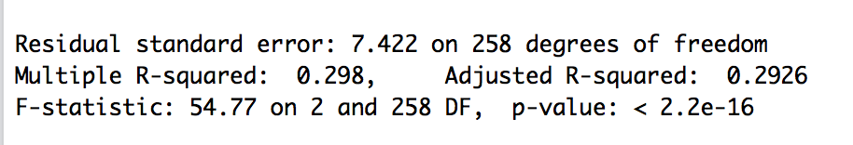
Overall Model
After data screening, we want to know if our regression worked!
Start with the overall model – is it significant?
summary(model)
F(2, 258) = 54.77, p < .001, R² = .30

Slide 33
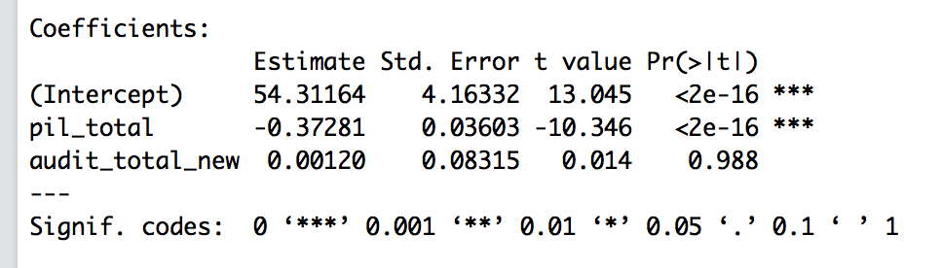
What about the predictors?
Look in the coefficients section.
Meaning was significant, b = -0.37, t(258) = -10.35, p < .001
Alcohol was not, b = 0.001, t(258) = 0.01, p = .99

Slide 34
Predictors
Two concerns:
What if I wanted to use beta because these are very different scales?
What about an effect size for each individual predictor?

Slide 35
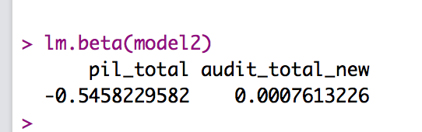
Predictors - Beta
You will need the QuantPsyc package for beta.
lm.beta(model)

Slide 36
R
Multiple correlations = R
All overlap in Y
A+B+C/(A+B+C+D)
IV 1
DV Variance
E
D
A
IV 2
B
C
F
G

Slide 37
SR
Semipartial correlations = sr
Unique contribution of IV to R² for those IVs
Increase in proportion of explained Y variance when X is added to the equation
A/(A+B+C+D)
IV 1
DV Variance
E
D
A
IV 2
B
C
F
G

Slide 38
PR
Partial correlation = pr
Proportion in variance in Y not explained by other predictors but this X only
A/(A+D)
Pr > sr
IV 1
DV Variance
E
D
A
IV 2
B
C
F
G

Slide 39
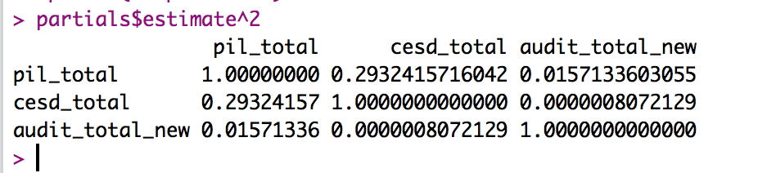
Predictors - Partials
Remember to square them!
New code, so you don’t forget:
partials = pcor(dataset)
partials$estimate^2

Slide 40
Predictors - Partials
Meaning was significant, b = -0.37, t(258) = -10.35, p < .001, pr² = .29
Alcohol was not, b = 0.001, t(258) = 0.01, p = .99, pr² < .01

Slide 41
Hierarchical Regression Dummy Coding

Slide 42
Hierarchical Regression
Known predictors (based on past research) are entered into the regression model first.
New predictors are then entered in a separate step/block.
Experimenter makes the decisions.

Slide 43
Hierarchical Regression
It is the best method:
Based on theory testing.
You can see the unique predictive influence of a new variable on the outcome because known predictors are held constant in the model.
Bad Point:
Relies on the experimenter knowing what they’re doing!

Slide 44
Hierarchical Regression
Answers the following questions:
Is my overall model significant?
Is the addition of each step significant?
Are the individual predictors significant?

Slide 45
Hierarchical Regression
Uses:
When a researcher wants to control for some known variables first.
When a researcher wants to see the incremental value of different variables.

Slide 46
Hierarchical Regression
Uses:
When a researcher wants to discuss groups of variables together (SETS → especially good for highly correlated variables).
When a researcher wants to use categorical variables with many categories (use as a SET).

Slide 47
Categorical Predictors
So what do you do when you have predictors with more than 2 categories?
DUMMY CODING
Cool news: If your variable is factored in R, it does that for you automatically. ☺

Slide 48
Dummy Coding
 | Dummy 1 NoT v Placebo | Dummy 2 NoT v Paxil | Dummy 3 NoT v Effexor | Dummy 4 NoT v Cheerup
No Treatment | 0 | 0 | 0 | 0
Placebo | 1 | 0 | 0 | 0
Paxil | 0 | 1 | 0 | 0
Effexor | 0 | 0 | 1 | 0
Cheerup | 0 | 0 | 0 | 1
How many dummy coded variables will you get for a categorical variable? - Number of categories – 1
The all zero group is the control group or comparison group.

Slide 49
Hierarchical/Categorical Predictors
Example!
C7 dummy code.sav
IVs:
Family history of depression
Treatment for depression (categorical)
DV:
Rating of depression after treatment

Slide 50
Hierarchical/Categorical Predictors
First model = after ~ family history
Controls for family history before testing if treatment is significant
Second model = after ~ family history + treatment
Remember you have to leave in the family history variable or you aren’t actually controlling for it.

Slide 51
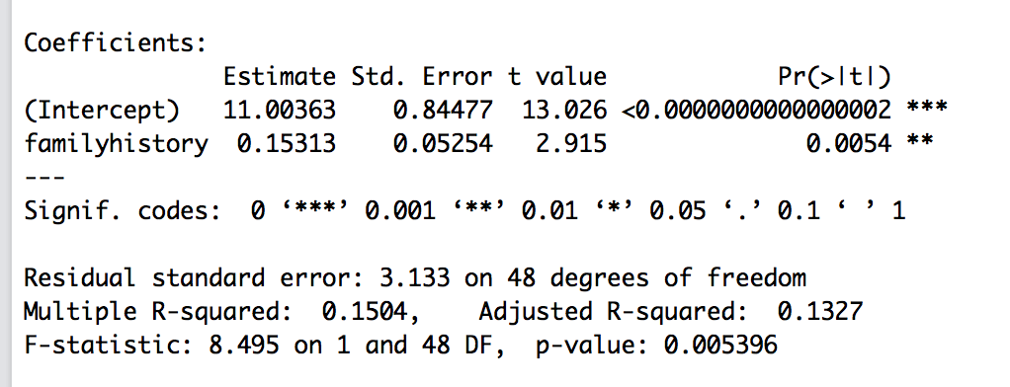
Hierarchical/Categorical Predictors
Model 1
Model 1 is significant, F(1, 48) = 8.50, p = .005, R² = .15
Family history is significant, b = 0.15, t(48) = 2.92, p = .005, pr² = .15

Slide 52
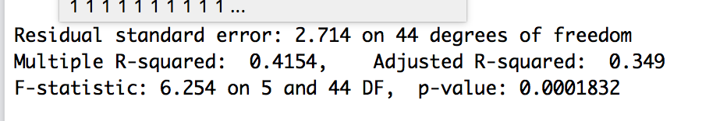
Hierarchical/Categorical Predictors
Model 2
I can see that the overall model is significant
But what if the first model was significant and then this model isn’t actually any better and it’s just overall significant because the first model was. (or basically how one variable runs the show).

Slide 53
Hierarchical/Categorical Predictors
Compare models with the anova() function.
You want to show the addition of your treatment variable added significantly to the equation.
Basically is the change in R² > 0?

Slide 54
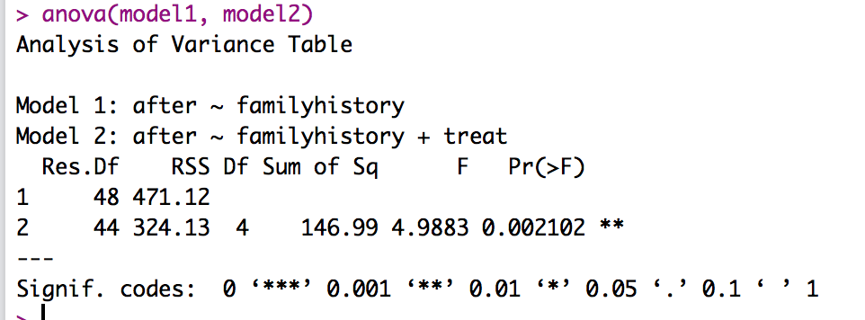
Hierarchical/Categorical Predictors
Yes, it was significant:
ΔF(4, 44) = 4.99, p = .002, ΔR² = .27
So the addition of the treatment set was significant.

Slide 55
Categorical Predictors
Remember dummy coding equals:
Control group to coded group
Therefore negative numbers = coded group is lower
Positive numbers = coded group is higher
b = difference in means
Use tapply() to find the means **

Slide 56
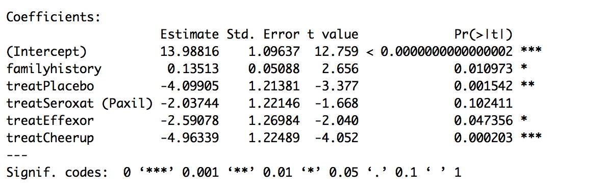
Categorical Predictors
Placebo < No Treatment
Paxil = No Treatment
Effexor < No Treatment
Cheer Up < No Treatment
NOT ALL PAIRWISE

Slide 57
Categorical Predictors
You could do pr² for each pairwise grouping
(t²) / (t² + df residual)
Or you could calculate cohen’s d, since these are mean comparisons.

Slide 58
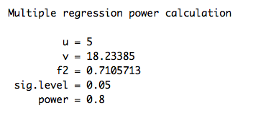
Power
Power is the same function we’ve been using for two-way ANOVAs
pwr.f2.test(u = df model,
v = NULL,
f2 = converted f value,
sig.level = .05,
power = .80)
Remember sample size is v + k + 1 where k is the predictors

